Slide 1
Chapter 7
Quantum Statistics
In Boltzmann statistics, small system was assumed to be in good thermal contact with reservoir → exchange of energy was allowed and as a result
Temperature of the system = Temperature of the reservoir
System was not allowed to exchange particles with the environment (reservoir)
It is useful to consider a system that can exchange particles with the environment too.
In this chapter we will consider good Thermal and Diffusive contact

Slide 2
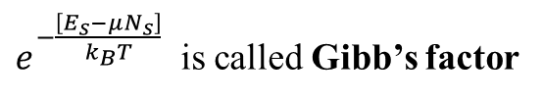
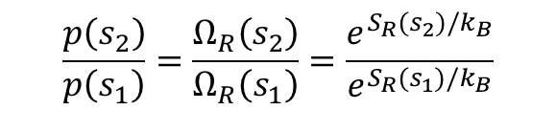
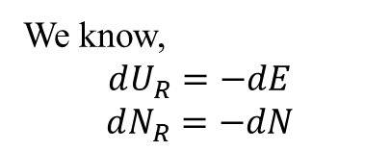
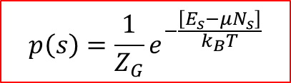
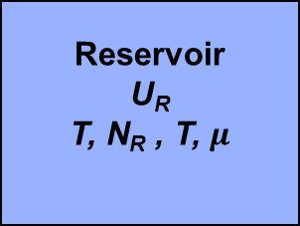
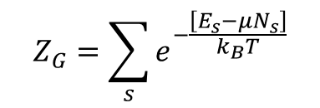



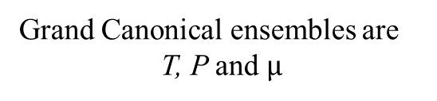
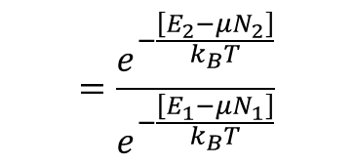

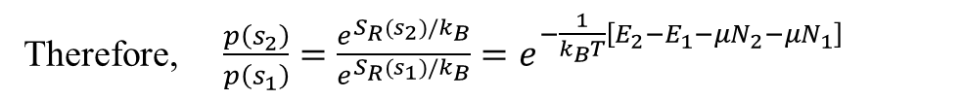

Reservoir
U_{R}
T, N_{R} , T, $μ$
$$\frac{p\left(s_{2}\right)}{p\left(s_{1}\right)}=\frac{Ω_{R}\left(s_{2}\right)}{Ω_{R}\left(s_{1}\right)}=\frac{e^{S_{R}(s_{2})/k_{B}}}{e^{S_{R}(s_{1})/k_{B}}}$$
System
E, N, T
$dS_{R}=\frac{1}{T}[dU_{R}+PdV_{R}−μdN_{R}]$
➔ $dS_{R}=\frac{1}{T}[dU_{R}−μdN_{R}]$
We know,
$$dU_{R}=−dE$$
$$dN_{R}=−dN$$
As $dV_{R}$ is negligible, while $dN_{R}≠0$
$dS_{R}=−\frac{1}{T}\left[dE−μdN\right]=−\frac{1}{T}\left[E_{2}−E_{1}−μN_{2}−μN_{1}\right]$
$$=\frac{e^{−\frac{\left[E_{2}−μN_{2}\right]}{k_{B}T}}}{e^{−\frac{\left[E_{1}−μN_{1}\right]}{k_{B}T}}}$$
Therefore, $\frac{p\left(s_{2}\right)}{p\left(s_{1}\right)}=\frac{e^{S_{R}(s_{2})/k_{B}}}{e^{S_{R}(s_{1})/k_{B}}}=e^{−\frac{1}{k_{B}T}\left[E_{2}−E_{1}−μN_{2}−μN_{1}\right]}$
OR
$$p(s)∝e^{−\frac{\left[E_{s}−μN_{s}\right]}{k_{B}T}}$$
$$p\left(s\right)=\frac{1}{Z_{G}}e^{−\frac{\left[E_{s}−μN_{s}\right]}{k_{B}T}}$$
Quantum distribution and is called
Grand Canonical
$e^{−\frac{\left[E_{s}−μN_{s}\right]}{k_{B}T}}$ is called Gibb’s factor
Grand Canonical ensembles are
T, P and $μ$
$Z_{G}$ is Grand partition function
$$Z_{G}=\sum_{s}{e^{−\frac{\left[E_{s}−μN_{s}\right]}{k_{B}T}}}$$
Normalization condition →
Sum of all Gibb’s factor

Slide 3
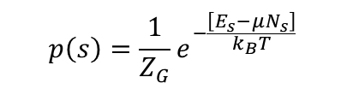


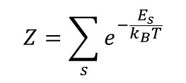


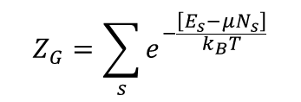
Common Ensembles
Micro Canonical
Energy and Number of particles are fixed
Temperature is exchanged with reservoir
System is isolated.
Constraints: U, V and N are constant
Ensembles E, V and N
$$p_{s}=\frac{Ω}{\sum_{s}{Ω}}$$
Natural Thermodynamic Potential, $S=k_{B}lnΩ$
Canonical
Boltzmann statistics
Temperature and Number of particles are fixed
Energy is exchanged with environment
Volume change of the reservoir is negligible.
The system is in good thermal contact with reservoir.
Constraints: T, V and N are constant.
$$p\left(s\right)=\frac{1}{Z}e^{−\frac{E_{S}}{k_{B}T}}$$
$$Z=\sum_{s}{e^{−\frac{E_{s}}{k_{B}T}}}$$
Ensembles T, V and N
Natural Thermodynamic Potential, $F\left(T, V, N\right)=−k_{B}TlnZ$
Grand Canonical
Quantum statistics
Energy and particles are exchanged with environment
Volume change of the reservoir is negligible.
Temperature chemical potential are fixed
The system is in good thermal and diffusive contacts with reservoir. Constraints: T, V and μ are constant.
$$p\left(s\right)=\frac{1}{Z_{G}}e^{−\frac{\left[E_{s}−μN_{s}\right]}{k_{B}T}}$$
$$Z_{G}=\sum_{s}{e^{−\frac{\left[E_{s}−μN_{s}\right]}{k_{B}T}}}$$
Ensembles T, V and μ
Natural Thermodynamic Potential $φ\left(T, V, μ\right)=−k_{B}TlnZ_{G}$
$φ$ is Grand or Landau Potential

Slide 4

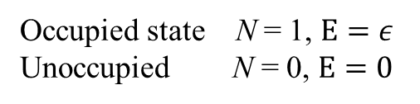
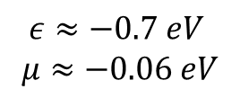


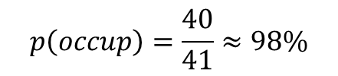
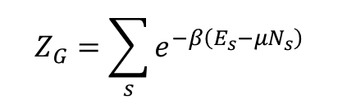

Carbon Monoxide Poisoning
O₂
Hemoglobin carries oxygen in the blood. Single hemoglobin molecule has molecule has 4 adsorption site for O₂
O₂
HG
O₂
For simplicity, let’s consider one site where O₂ can be occupied and assume that it is not affected by other 3 sites
O₂
That means we a system which has 2 possible microstates:
Occupied or Unoccupied
Let’s say the energy of these states are $ε$ and 0
Occupied state N = 1, $E=ε$
Unoccupied N = 0, $E=0$
$$Z_{G}=\sum_{s}{e^{−β\left(E_{s}−μN_{s}\right)}}$$
We can write
$=e^{−0}+e^{−β(ε−μ)}=1+$ $e^{−β(ε−μ)}$
$$Z_{G}=1+e^{−\frac{\left(ε−μ\right)}{k_{B}T}}$$
At human body Temp (~ 310 K)
$$ε≈−0.7 eV$$
$$μ≈−0.06 eV$$
➔ $Z_{G}≅1+40$
$$k_{B}=8.62×{10}^{−5}eV/K$$
Although value of μ in the cell is relatively lower than in the lungs
The probability that a HG site will be occupied is
$$p\left(occup\right)=\frac{40}{41}≈98\%$$

Slide 5
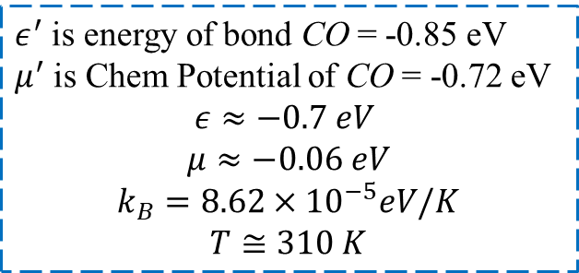
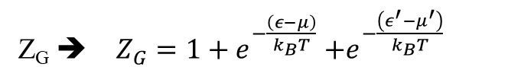
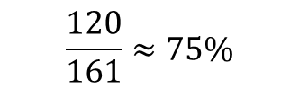
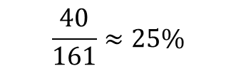

Carbon Monoxide Poisoning --- cont
Now assume CO is present in the lungs
$ε^{′}$ is energy of bond CO = -0.85 eV
$μ^{′}$ is Chem Potential of CO = -0.72 eV
$$ε≈−0.7 eV$$
$$μ≈−0.06 eV$$
$$k_{B}=8.62×{10}^{−5}eV/K$$
$$T≅310 K$$
Z_{G} ➔ $Z_{G}=1+e^{−\frac{\left(ε−μ\right)}{k_{B}T}}$ $+e^{−\frac{\left(ε^{′}−μ^{′}\right)}{k_{B}T}}$
$$Z_{G}=1+40+120=161$$
Now the probability that a HG site will be occupied with O₂ is
$$\frac{40}{161}≈25\%$$
Now the probability that a HG site will be occupied with CO is
$$\frac{120}{161}≈75\%$$
This situation will cause the lack of O₂ in blood

Slide 6
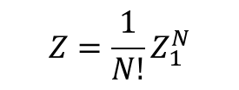
Bosons and Fermions
Most important application of Gibb’s factor is in Quantum Statistics
Study of the dense system
Where 2 or more particle have a reasonable chance of occupying the same single particle-state
Instead of finding probability of state of a particle, we can look into probability of a particular site being occupied or not
I we have more particles than available sites, all states will be occupied.
If less sites are available than the particle, then particles will compete to occupy
Let’s start with identical (indistinguishable) and non-interacting N particles
We previously had the Partition function
$$Z=\frac{1}{N!}Z_{1}^{N}$$
It will not work
But that was the case when particles occupied different energy states, and all had different states
Now, different particles compete to occupy the site that has same energy state

Slide 7


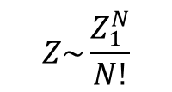

Bosons and Fermions
Let’s consider simple example: 2 non-interacting particles
Either of which can occupy any 5 states available
(assume all 5 available states have zero energy)
All Boltzmann factors $e^{−βE_{s}}$ will be zero
If 2 particles are not identical (are distinguishable)
Total no. of system states = $5×5 OR Z_{1}×Z_{2}$
$$Z=Z_{1}^{N}$$
If 2 particles are identical (are indistinguishable)
$$Z\sim \frac{Z_{1}^{N}}{N!}$$
1 1 0 0 0
1 0 1 0 0
1 0 0 1 0
1 0 0 0 1
0 1 1 0 0
0 1 0 1 0
0 1 0 0 1
0 0 1 1 0
0 0 1 0 1
0 0 0 1 1
2 0 0 0 0
0 2 0 0 0
0 0 2 0 0
0 0 0 2 0
0 0 0 0 2
True only if Z₁ >> N
No 2-identical particles can be in same state
Obey Pauli Exclusion Principle
Fermions
Particles with spin 1/2 . 3/2, 5/2, …
Total no of stats for Fermions are 10
Electrons, Protons, neutrons, He³
Bosons
2 identical particles occupying the same state
Particles with spin. 0, 1, 2, 3, …
Do not obey Pauli Exclusion principle
For Bosons total number of states are 15
Photons, He⁴

Slide 8
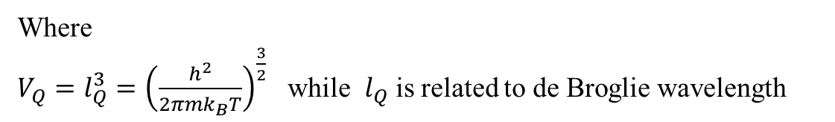


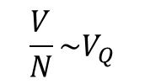
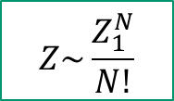

Bosons and Fermions
If number of available states , Z₁ >> N
Then it does not matter if you have Bosons or Fermions
We know
$$Z_{1}=\frac{V}{V_{Q}}Z_{int}$$
Z_{int} due to internal
Where
$V_{Q}=l_{Q}^{3}={\left(\frac{h^{2}}{2πmk_{B}T}\right)}^{\frac{3}{2}}$ while $l_{Q}$ is related to de Broglie wavelength
If Z₁ >> N ➔ $\frac{V}{N}≫V_{Q}$
Average distance between particles >> de Broglie wavelength.
$$Z\sim \frac{Z_{1}^{N}}{N!}$$
When de Broglie wavelengths begins overlapping , we have Quantum gas
$$\frac{V}{N}\sim V_{Q}$$
Now particles must compete to occupy the available states
As
Z₁ ~ N
$$Z\sim \frac{Z_{1}^{N}}{N!}$$
Here we need to consider one single-particle state of a system (say a particle in a box)
Instead of finding probability of a particle’s state, it’s much easier to find the probability of a particular state’s occupancy – probability of occupancy

Slide 9
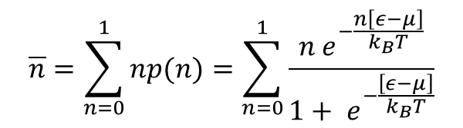

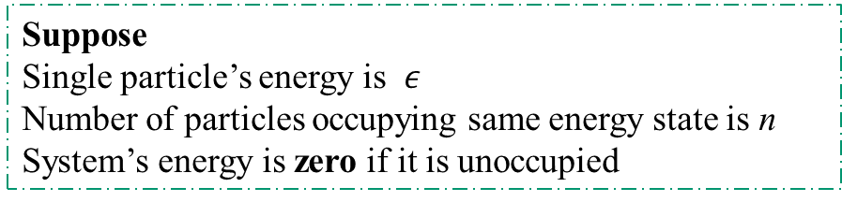
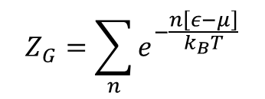

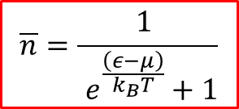
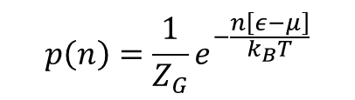
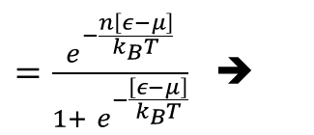
Bosons and Fermions
Suppose
Single particle’s energy is $ε$
Number of particles occupying same energy state is n
System’s energy is zero if it is unoccupied
When system is occupied with n particles, it’s energy will be $nε$
Therefore, the probability of occupancy of the state (system) will be
$$p\left(n\right)=\frac{1}{Z_{G}}e^{−\frac{n\left[ε−μ\right]}{k_{B}T}}$$
The probability that a system is occupied with n particles
$$Z_{G}=\sum_{n}{e^{−\frac{n\left[ε−μ\right]}{k_{B}T}}}$$
For Fermions
$$n=0 OR n=1$$
$Z_{G}=1+$ $e^{−\frac{\left[ε−μ\right]}{k_{B}T}}$
We can get average number of particles occupying a particular state
$$\overline{n}=\sum_{n=0}^{1}{np(n)}=\sum_{n=0}^{1}{\frac{n e^{−\frac{n\left[ε−μ\right]}{k_{B}T}}}{1+ e^{−\frac{\left[ε−μ\right]}{k_{B}T}}}}$$
$=\frac{e^{−\frac{n\left[ε−μ\right]}{k_{B}T}}}{1+ e^{−\frac{\left[ε−μ\right]}{k_{B}T}}}$ ➔
$$\overline{n}=\frac{1 }{ e^{\frac{\left(ε−μ\right)}{k_{B}T}}+1}$$
Fermi-Dirac distribution

Slide 10
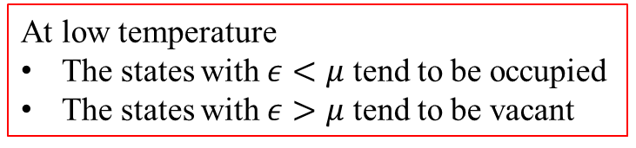
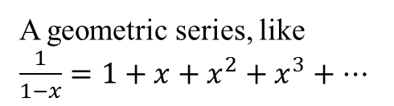





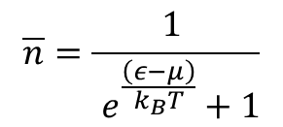



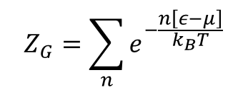






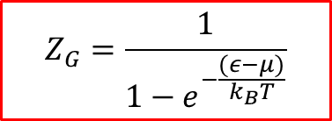
Fermions
Fermi-Dirac distribution
$$\overline{n}=\frac{1 }{ e^{\frac{\left(ε−μ\right)}{k_{B}T}}+1}$$
As $T→0$
For Fermions
If $ε≫μ$
$$\overline{n}→0$$
At low temperature
The states with $ε<μ$ tend to be occupied
The states with $ε>μ$ tend to be vacant
If $ε≪μ$
$$\overline{n}→1$$
1
$$\overline{n}$$
T = 0 K
High temperature means when $k_{B}T>\left(ε−μ\right)$
Higher T
$$ε=μ$$
$$ε$$
Fermi Energy is defined as “The highest occupied energy state at 0 K”
If $ε=μ$, the occupancy is 50%
$$ε_{F}=μ(T=0)$$
For Bosons
$$n=0,1 2, 3, …(any postive integer)$$
$$Z_{G}=\sum_{n}{e^{−\frac{n\left[ε−μ\right]}{k_{B}T}}}$$
$=1+$ $e^{−\frac{\left[ε−μ\right]}{k_{B}T}}+e^{−2\frac{\left[ε−μ\right]}{k_{B}T}}+⋯$
A geometric series, like
$\frac{1}{1−x}=1+x+x^{2}+x^{3}+⋯$
Therefore, for Bosons
$$Z_{G}=\frac{1}{1−e^{−\frac{(ε−μ)}{k_{B}T}}}$$

Slide 11


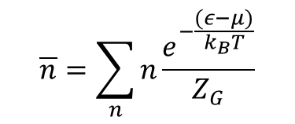
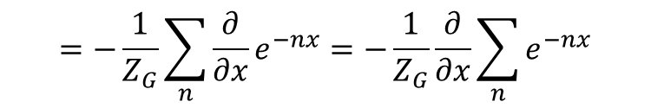

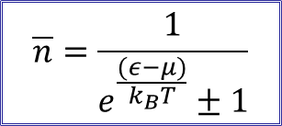
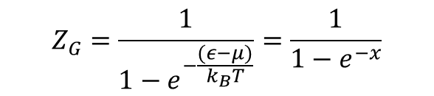

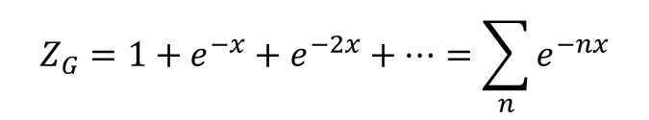



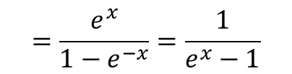
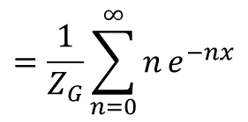
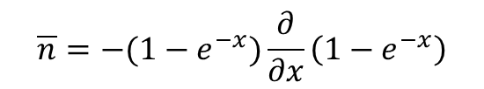

Bosons and Fermions
For Bosons
$$Z_{G}=\frac{1}{1−e^{−\frac{(ε−μ)}{k_{B}T}}}=\frac{1}{1−e^{−x}}$$
$$\overline{n}=\sum_{n}{n}\frac{e^{−\frac{(ε−μ)}{k_{B}T}}}{Z_{G}}$$
$$=\frac{1}{Z_{G}}\sum_{n=0}^{∞}{n}e^{−nx}$$
Here $x=(ε−μ)/k_{B}T$
$$Z_{G}=1+e^{−x}+e^{−2x}+⋯=\sum_{n}{e^{−nx}}$$
$$=−\frac{1}{Z_{G}}\sum_{n}{\frac{∂}{∂x}e^{−nx}}=−\frac{1}{Z_{G}}\frac{∂}{∂x}\sum_{n}{e^{−nx}}$$
$\overline{n}=$ $−\frac{1}{Z_{G}}\frac{∂Z_{G}}{∂x}$
$$\overline{n}=−(1−e^{−x})\frac{∂}{∂x}\left(1−e^{−x}\right)$$
$$=\frac{e^{x}}{1−e^{−x}}=\frac{1}{e^{x}−1}$$
Therefore, for Bosons
$$\overline{n}=\frac{1}{e^{\frac{(ε−μ)}{k_{B}T}}−1}$$
Bose-Einstein distribution
As $T→0$
In general
If $ε≫μ$
$$\overline{n}→0$$
$$\overline{n}=\frac{1}{e^{\frac{(ε−μ)}{k_{B}T}}±1}$$
+ for Fermions
- For Bosons
If $ε≪μ$
$$\overline{n}→∞$$

Slide 12
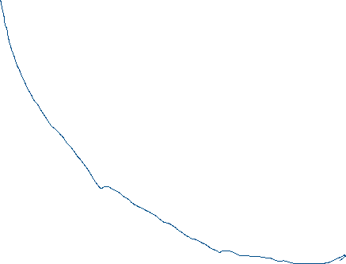
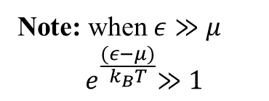



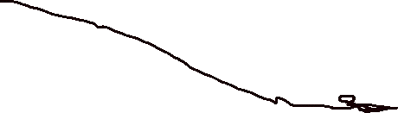
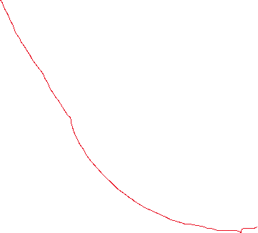


$$\overline{n}$$
Boltzmann distribution
BE distribution
1
FD distribution
$$ε$$
Note: when $ε≫μ$
$${ e}^{\frac{(ε−μ)}{k_{B}T}}≫1$$
$$μ$$
This condition $(ε−μ)≫k_{B}T$ is equivalent to $Z_{1}≫N$
That is the number of available states are very large as compared to number of particles.
FD and BE reduce to Boltzmann distribution
All distributions agree for $(ε−μ)≫k_{B}T$

Slide 13

Degenerate Fermi Gas
Now we know how to calculate $\overline{n}$, mean number of occupants in a single-particle state for both types of particles – Fermions and Bosons, in terms of $ε, μ \& T$
But, to apply this idea to a particular system, we still need the energies of all the microstates of all that system.
The problem of Quantum Mechanics
This question can become extremely difficult in many cases.
Mostly, we consider a particle in a box, where quantum wave functions are simple, and corresponding energies can be found relatively easily
Particles can be, for example, electrons in a metal, neutrons in a neutron star, atoms in a fluid at low temperature, photons inside a hot oven or phonons
A phonon is a quantized unit of vibrational energy in a solid
1st thing we need is $μ$
so that we can decide if particles are Fermions or Bosons
An important application of quantum mechanics and Fermi-Dirac statistics is
Degenerate Fermi Gas

Slide 14







Degenerate Fermi Gas Cont.
FD statistics is applicable
Consider a gas of Fermions at very low temperature
Best example is “conduction electrons inside a chunk of metal at low temperature
$$V_{Q}={\left(\frac{h^{2}}{2πmk_{B}T}\right)}^{3/2}=65 {nm}^{3}$$
Fora typical metal, assuming 1 conduction electron from each atom,
$$\frac{V}{N}\sim 0.008 {nm}^{3}$$
Condition $\frac{V}{N}≪V_{Q}$
We can say “we have quantum gas of fermions
Suppose $T→0$ ➔ $ε=μ(T=0)$
Called Fermi energy, $ε_{F}$
When Fermion gas is cold, all states below $ε_{F}$ are occupied and all states above $ε_{F}$ are unoccupied
$$\overline{n}= \begin{matrix}1 ε<μ \\ 0 ε>μ\end{matrix}$$
A step function
Fermions gas is said to be degenerate
This has nothing to do with splitting of energy level which is also called degeneracy of energy level
To find $ε_{F}$, we need total number of fermions (electrons)

Slide 15










Degenerate Fermi Gas Cont.
Imagine an empty cubical box and start adding electrons into it one by one at a time
Each electron will go to lowest energy state available below $ε_{F}$
To add more electrons, you need to give an electron the energy dU, $μ=ε_{F}$
We know $μ=\frac{dU}{dN}$ (at constant S and V)
$dN=1$ ➔ $dU=μ$
Assuming electrons are free particles and there is no external force (infect, there will be electrostatic force due to + ions), electrons are confined to volume, $V=L^{3}$
We need to define energy wave function of a free electron in a box
In 1-dimensional box, we know $ε_{n}=\frac{h^{2}n^{2}}{8mL^{2}}$ (standing waves on a string)
$$ε_{n}=\frac{h^{2}}{8mL^{2}}\left(n_{x}^{2}+n_{y}^{2}+n_{z}^{2}\right)$$
n is positive integer
In 3-dimensional box, we will have
When electrons a re added, they settle in $\frac{1}{8}$ (a sphere of radius $n_{max}$)
$$n_{z}$$
$$ε_{F}=\frac{h^{2}}{8mL^{2}}n_{max}^{2}$$
$ε_{F}$ is energy of the state at the surface of a sphere – Fermi surface
$$n_{y}$$
$$ε_{F}=μ(T→0)$$
$$n_{x}$$

Slide 16



















Degenerate Fermi Gas Cont.
$$N=\frac{1}{8}\left(\frac{3}{4}πn_{max}^{3}\right)$$
But electrons have spin – 2 spin states for each particle)
Total number of particles,
$N=\frac{1}{4}\left(\frac{3}{4}πn_{max}^{3}\right)=\frac{π}{3}$ $n_{max}^{3}$
$$n_{max}={\left(\frac{3N}{π}\right)}^{1/3}$$
$$OR$$
$$ε_{F}=\frac{h^{2}}{8mL^{2}}n_{max}^{2}$$
$$ε_{F}=\frac{h^{2}}{8m}{\left(\frac{3N}{πL^{3}}\right)}^{2/3}$$
$$ε_{F}=\frac{h^{2}}{8m}{\left(\frac{3N}{πV}\right)}^{2/3}$$
The energy
$$U=2\sum_{n_{x}}{}\sum_{n_{y}}{}\sum_{n_{z}}{ε(n)}$$
ndθ
Since sum is huge
$$U=2\iiint{ε\left(n\right)dn_{x}dn_{y}dn_{z}}$$
$$n_{z}$$
dn
$$θ$$
n
$$nsinθd∅$$
In spherical coordinate $\left(n, θ, ∅\right)$
$$n_{y}$$
$$∅$$
$$U=2\int_{0}^{n_{max}}{dn}\int_{0}^{\frac{π}{2}}{dθ}\int_{0}^{\frac{π}{2}}{d∅\left(n^{2}sinθ\right)ε(n)}$$
$$n_{x}$$
$$n=\sqrt{n_{x}^{2}+n_{y}^{2}+n_{z}^{2}}$$
$$dV=(dn)(ndθ)(nsinθd∅)$$

Slide 17














Degenerate Fermi Gas Cont.
$$U=2\int_{0}^{n_{max}}{dn}\int_{0}^{\frac{π}{2}}{dθ}\int_{0}^{\frac{π}{2}}{d∅\left(n^{2}sinθ\right)ε(n)}$$
$$=\frac{πh^{2}}{8mL^{2}}\left(\frac{n_{max}^{5}}{5}\right)$$
➔ $=\frac{3}{5}N\left(\frac{h^{2}}{8m}\right){\left(\frac{3N}{πV}\right)}^{2/3}$
$$U=\frac{3}{5}Nε_{F}$$
Average energy of a particle
$\overline{ε}=\frac{3}{5}$ $ε_{F}$
As thermal energy is $k_{B}T$
➔ $ε_{F}≫k_{B}T$
For a typical metal, $ε_{F}$ is few eV
${\text{And} \text{at} \text{room} \text{T} k}_{B}T\sim \frac{1}{40}eV$
Fermi Temperature,
$$T_{F}≡\frac{ε_{F}}{k_{B}}$$
As $P=−{\left(\frac{∂U}{∂V}\right)}_{S, N}$
➔ $P=−{\left(\frac{3}{5}\frac{∂Nε_{F}}{∂V}\right)}_{S, N}$
But $ε_{F}=\frac{h^{2}}{8m}{\left(\frac{3N}{πV}\right)}^{2/3}$
➔ $P=−\frac{3}{5}\frac{∂}{∂V}\left[\frac{3N}{5}\frac{h^{2}}{8m}{\left(\frac{3N}{π}\right)}^{2/3}V^{−2/3}\right]$
$$P=\frac{2}{3}\frac{U}{V}$$
Called Degeneracy
Pressure
Degeneracy pressure is responsible keeping matter from collapsing under huge electrostatic forces
It has nothing to do with electrostatic repulsive force. This is only due to Pauli Exclusion Principle

Slide 18












Degenerate Fermi Gas Cont.
$$B=−V{\left(\frac{∂P}{∂V}\right)}_{T}$$
Another measurable quantity is Bulk Modulus
$P=\frac{2}{3}\frac{U}{V}$
and $U=\frac{3}{5}N\left(\frac{h^{2}}{8m}\right){\left(\frac{3N}{πV}\right)}^{2/3}$
➔ $\frac{∂P}{∂V}=\frac{2}{3}\frac{∂}{∂V}\left(UV^{−1}\right)$
With some algebra ➔
$$B=\frac{10}{9}\frac{U}{V}$$
Heat Capacity
$$C=\frac{∂U}{∂T}$$
It can not be calculated under the assumption of T = 0
What happens when T is non-zero, still very low
At any temp, T
All particles have thermal energy $\sim k_{B}T$
But in a degenerate Fermi (electrons) gas, all energy states are already occupied ➔ most of the electrons can not acquire small energy, $k_{B}T$ since they can not jump to higher state (No vacancy)
$$\overline{n}$$
Only electrons close to Fermi surface (within energy $k_{B}T$ belwo $ε_{F}$) can acquire the energy and jump above Fermi surface
1
Number of electrons effected, $N_{eff}∝T$
T = 0 K
$$ε=μ$$
$$ε$$

Slide 19





Degenerate Fermi Gas Cont.
$$N_{eff}=N\frac{k_{B}T}{ε_{F}}$$
Therefore, the additional energy $∝N_{eff}k_{B}T OR Nk_{B}T\frac{k_{B}T}{ε_{F}}$
Additional energy $=\frac{π^{2}}{4}\frac{Nk_{B}^{2}T^{2}}{ε_{F}}$
➔ Total Thermal energy,
$$U=\frac{3}{5}Nε_{F}+\frac{π^{2}}{4}\frac{Nk_{B}^{2}T^{2}}{ε_{F}}$$
➔ $C_{V}={\left(\frac{∂U}{∂T}\right)}_{V}=\frac{π^{2}}{2}\frac{Nk_{B}^{2}T}{ε_{F}}$
The electronic contribution to heat capacity.
Lattice vibrations also contributes to C
Hence,
$T=0, C_{V}=0$ (3rd law of thermodynamics)
For low temperature, $T→0, C_{V}∝T$ (agrees with experimental data

Slide 20
Chapter 7: Practice Problems
7.9, 7.11, 7.13, 7.20, 7.25, 7.26 (a, b), 7.44 (a), 7.45, 7.46 (a, b, c), and 7.58.
Assignment# 10
7.6, 7.14, 7.16, 7.18, and 7.19
Due Friday, 4/29/2022
Exam-3, Friday, April 29?

